Slide 1
Linear regression (Julia)

Slide 2
topic
Linear Regression
Linear Regression in Julia

Slide 3
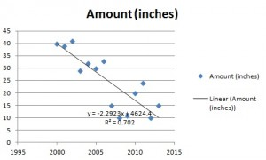
Linear Regression
What?
A way to model a relationship between two sets of variables
Linear regression equation can be used to make predictions about data.
Simple linear regression for the amount of rainfall per year.

Slide 4

Linear regression
y’ = a + bx

Slide 5


Linear Regression in julia
SUBJECT | AGE X | GLUCOSE LEVEL Y | XY | X² | Y²
1 | 43 | 99 | 4257 | 1849 | 9801
2 | 21 | 65 | 1365 | 441 | 4225
3 | 25 | 79 | 1975 | 625 | 6241
4 | 42 | 75 | 3150 | 1764 | 5625
5 | 57 | 87 | 4959 | 3249 | 7569
6 | 59 | 81 | 4779 | 3481 | 6561
Σ | 247 | 486 | 20485 | 11409 | 40022

Slide 6
code

